Slide 1
IPCV PROJECT 3D FACE reconstruction
TONGLI ZHU
QINGYI XU
Oceane thai

Slide 2
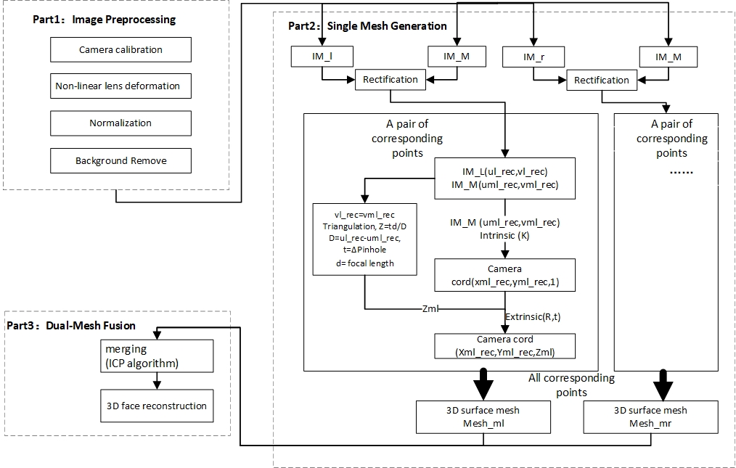
Steps overview

Slide 3
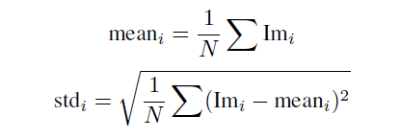
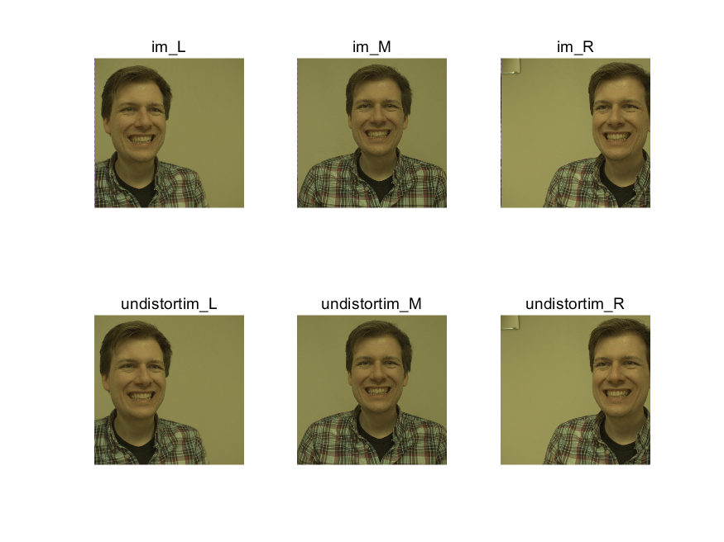
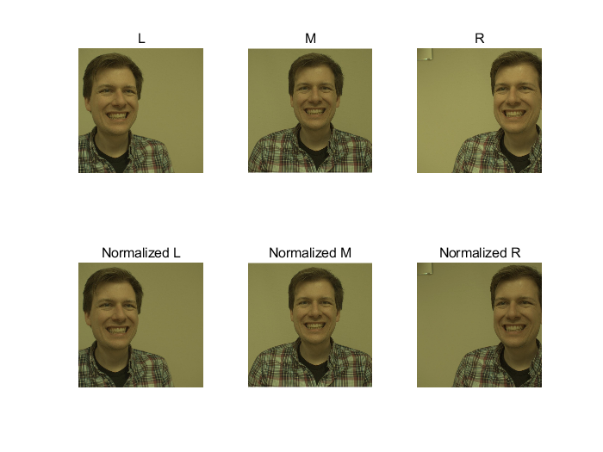
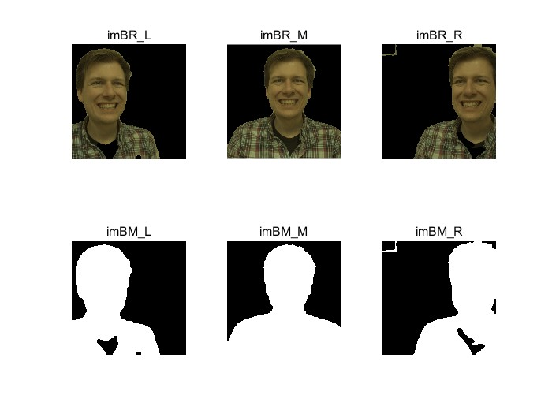
Part1 Preprocessing
Compensating nonlinear lens distortion
normalization
removing the background
Canny &morphology

Slide 4
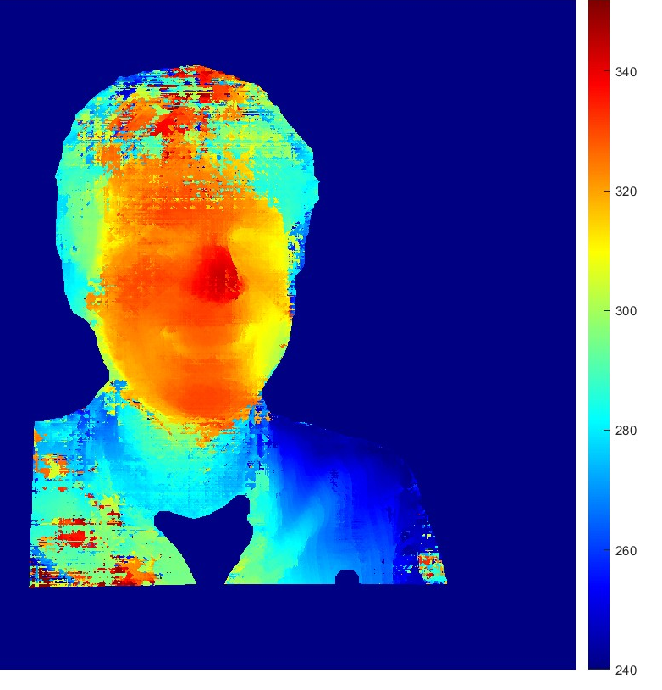
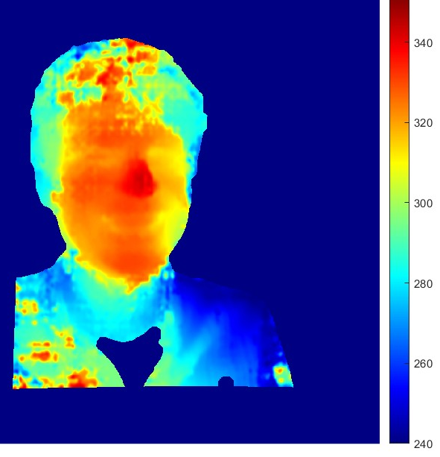
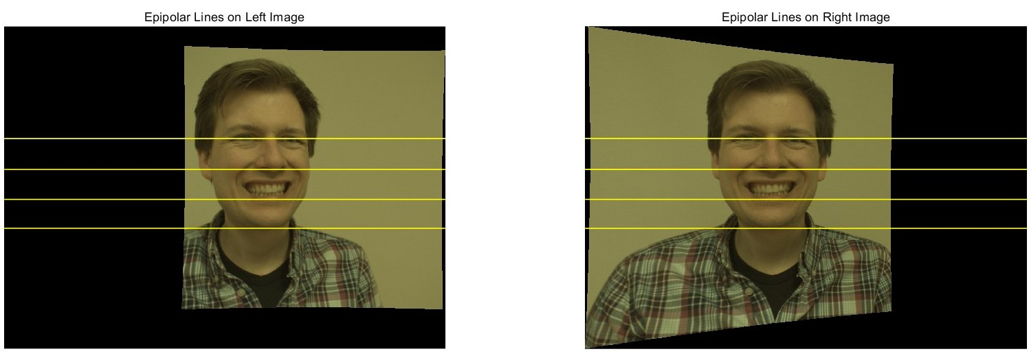
Part2 Single MESH generation
Rectification
Disparity estimation and optimization

Slide 5
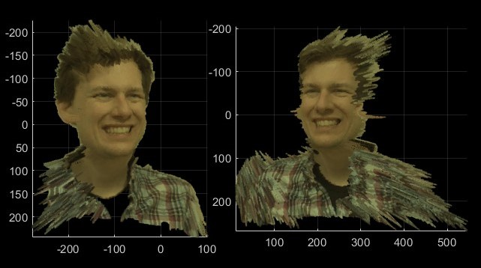
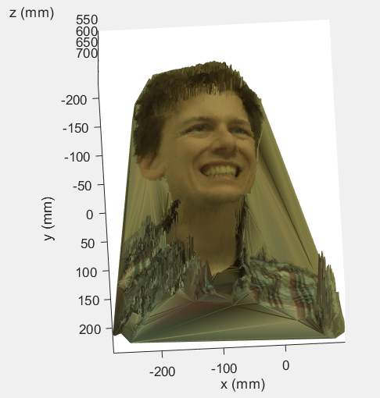
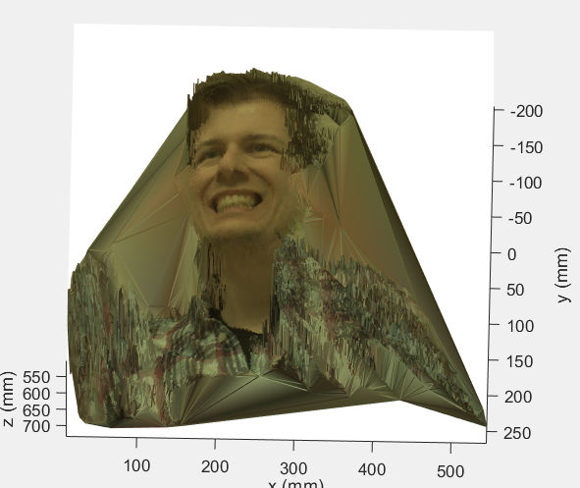
Part2 Single POINT could/mesh generation
Point cloud
MESH
Delaunay Triangulation

Slide 6
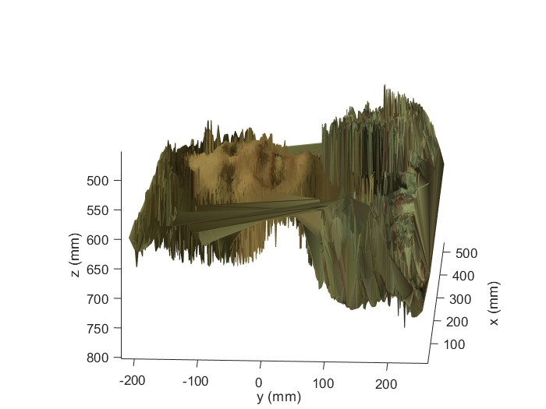
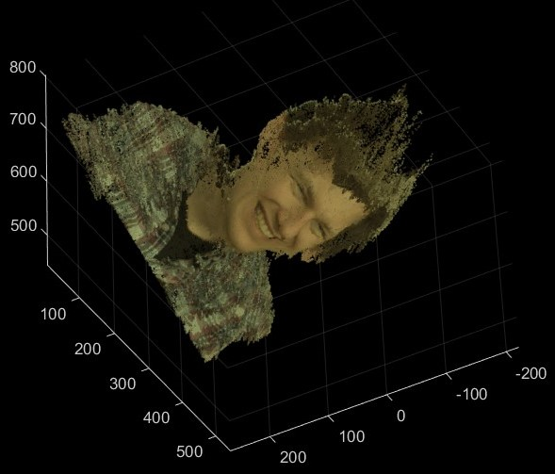
Part3 MERGING(ICP)
Point cloud
MESH

Slide 7
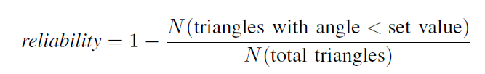
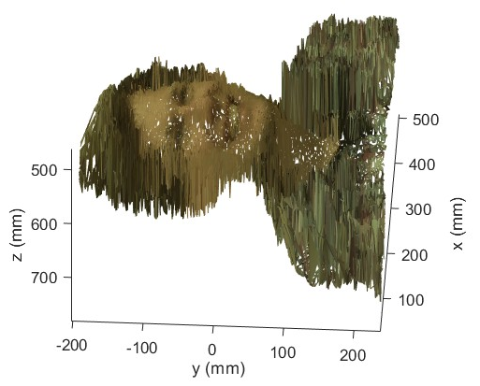
Evaluation and discussion
criteria
 | No constraints on side lengths | Side lengths < 2
Reliability (set value = 30°) | 53.79% | 59%
Appearance | Too much edges | Holes on the face

Slide 8
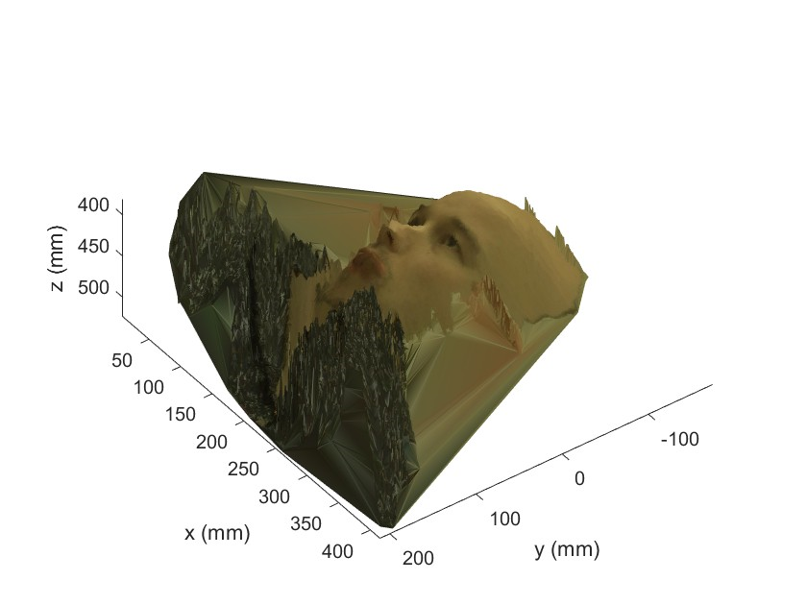
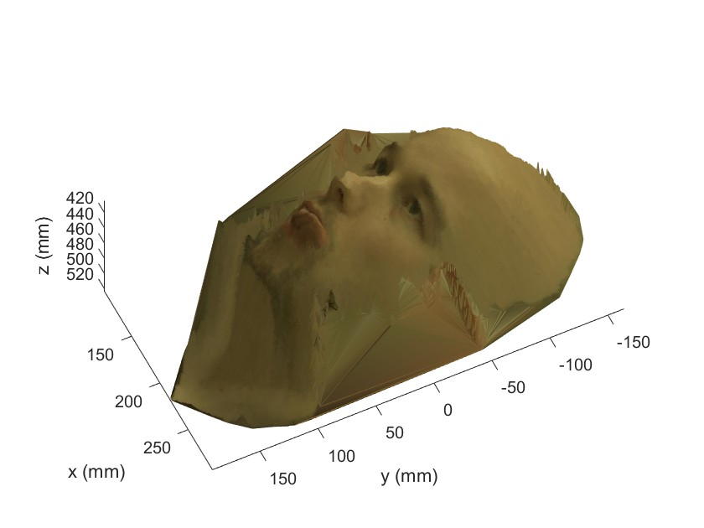
Evaluation and discussion
Improved background removal algorithm

Slide 9
Conclusion
KEY POINT | SELF-EVLUATION/SUGGESTIONS
Camera calibration | Good
Background removal | Good, but not precise enough
Single/merged point cloud | Good
Point Cloud to mesh | Lack of removing noise, cleaning data
Mesh merging | Using ICP merging the 2 point-clouds and transfer to mesh rather than merging the 2-single mesh

Slide 10
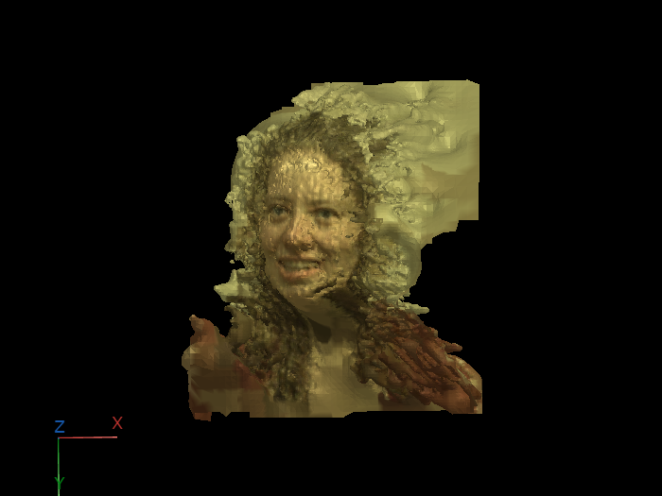
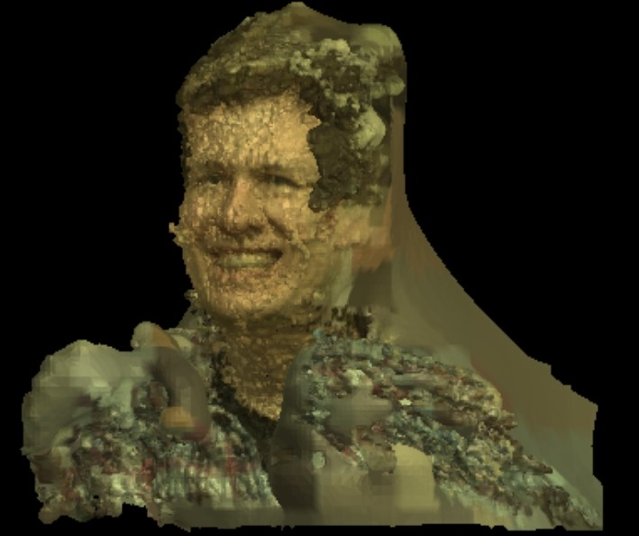
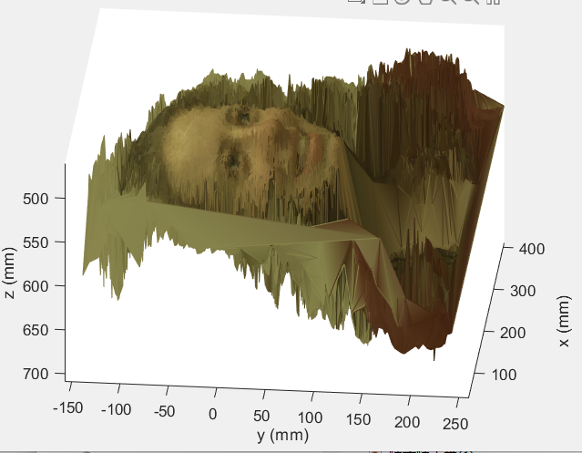
Other discussion
Mesh(Poisson reconstruction) generality

